Slide 1


Evaluating Serverless Machine Learning Performance On Google Cloud Run
PRERANA KHATIWADA
PRANJAL DHAKAL
Department of Computer and Information Sciences University of Delaware
Setting up a Google Cloud Project

Slide 2

What buzzword is hot today?

Slide 3
Answer: Serverless Containers
A cloud-native development model that allows developers to build and run applications without having to manage servers.
Run containerized applications that are cost effective.
Eliminates/minimizes the need for expensive onsite hardware, software and storage infrastructure.
Therefore, it's important to know how to package such applications as containers and deploy the application on the Google Cloud Platform.

Slide 4
Objective
To understand Microservice Architecture.
To learn about Containerization using Dockers and features offered by Google Cloud Platform.
To simulate different load scenarios and stress test the server that runs Machine Learning tasks.

Slide 5
Existing works
James Lewis first proposed the the term of microservices at a conference in San Francisco in 2012.
Netflix was one of the first companies to use the concept on a big scale, referring to it as "fine-grained service-oriented architecture".

Slide 6
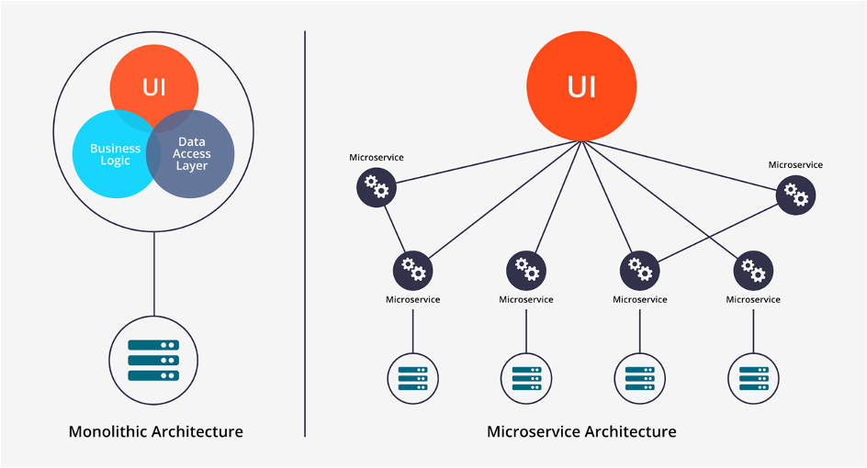
What is Microservice
Communicate with each other using REST API.
Microservice architecture has very good portability by using container technology like Docker.
Notes:
What is REST API?

Slide 7
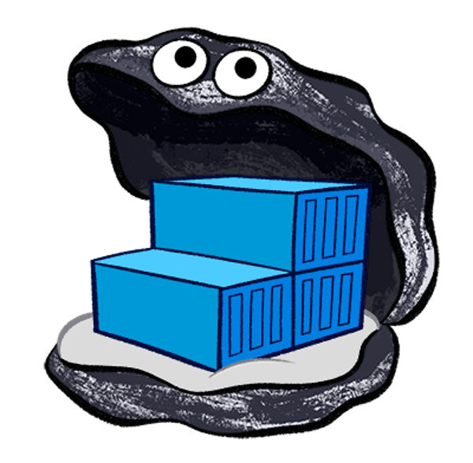
What is Docker
Containerization for software
Docker is a software platform that allows you to build, test, and deploy applications quickly, packaging software into standardized units called containers.
Docker uses resource isolation in the OS kernel to run multiple containers on the same OS.
Notes:
Open Source platform

Slide 8
Google Cloud Run
To develop and deploy highly scalable containerized applications on a serverless platform.
Developers can build and run applications without having to manage servers.
It performs automatic scaling depending on the request traffic.
Notes:
WHAT IS GOOGLE CONTAINER REGISTRY

Slide 9
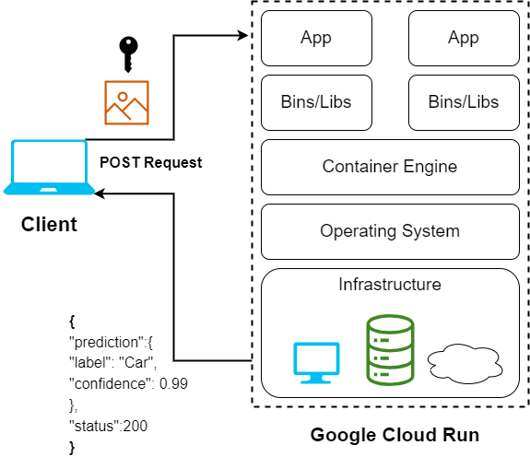
Proposed Model
Write a Flask app which will provide REST APIS that can be used by client to send request.
Our App will run Tensorflow MobileNetV2 image Classification Model.
Model classify images into one of 1000 categories.
The app is then containerized using Docker.
The containerized application is then deployed to GCP

Slide 10
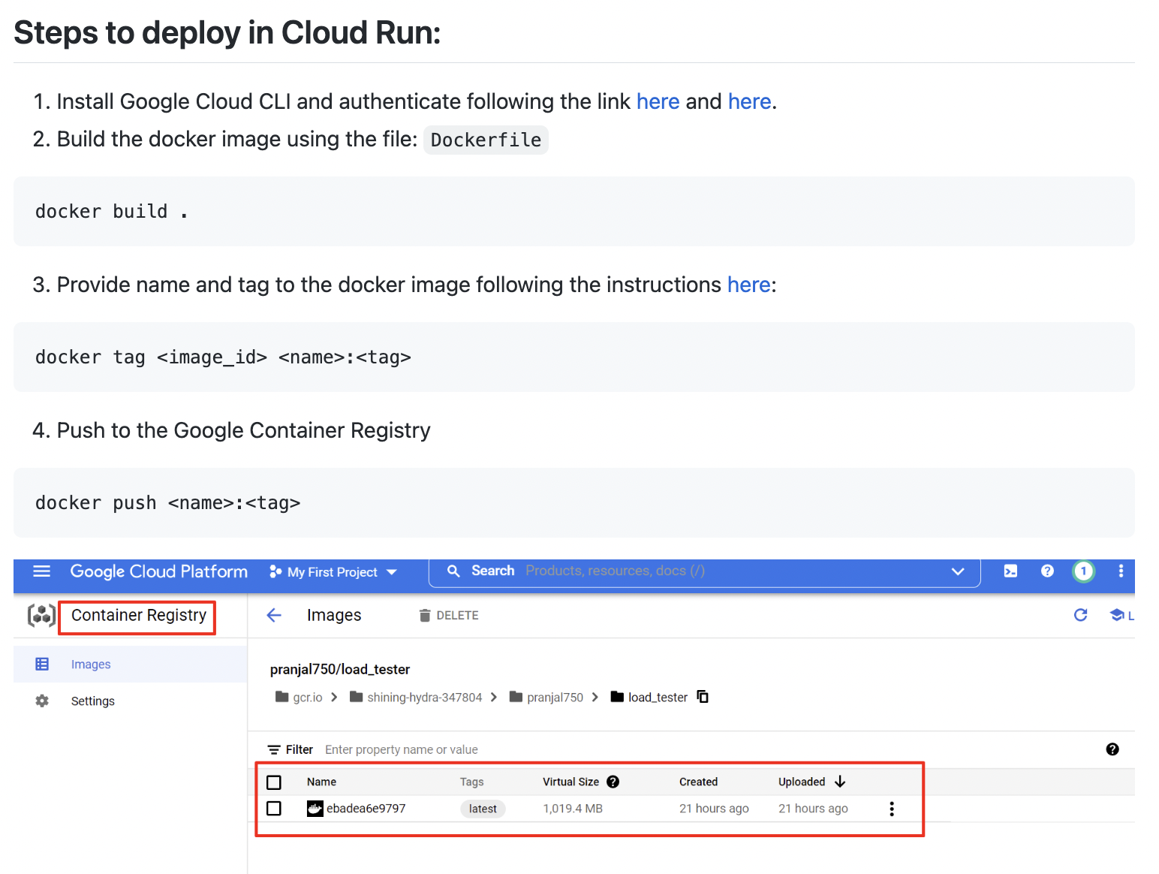

Slide 11
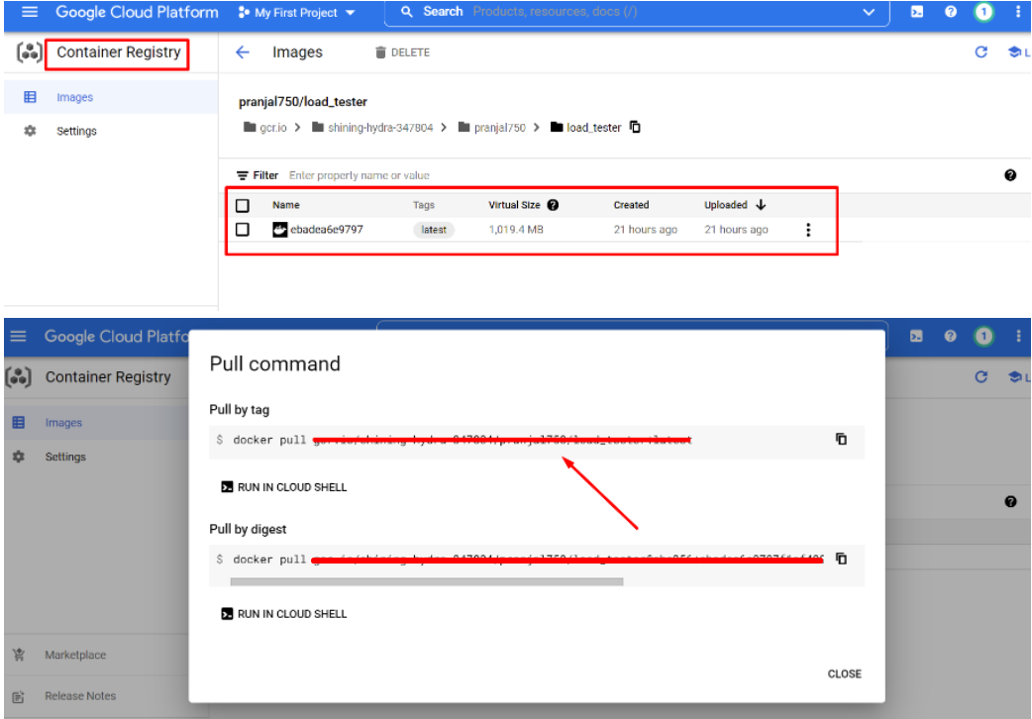

Slide 12
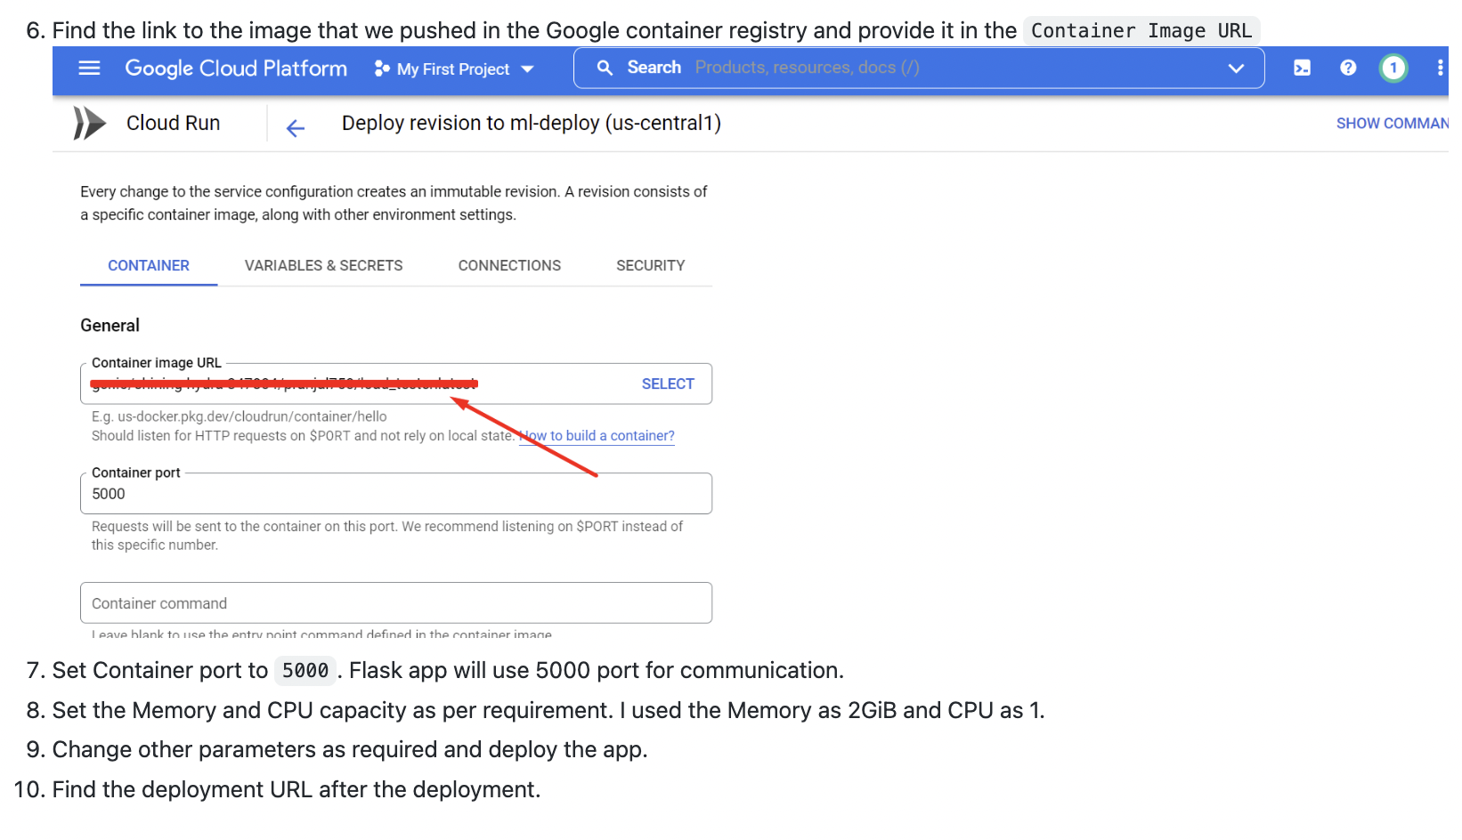

Slide 13
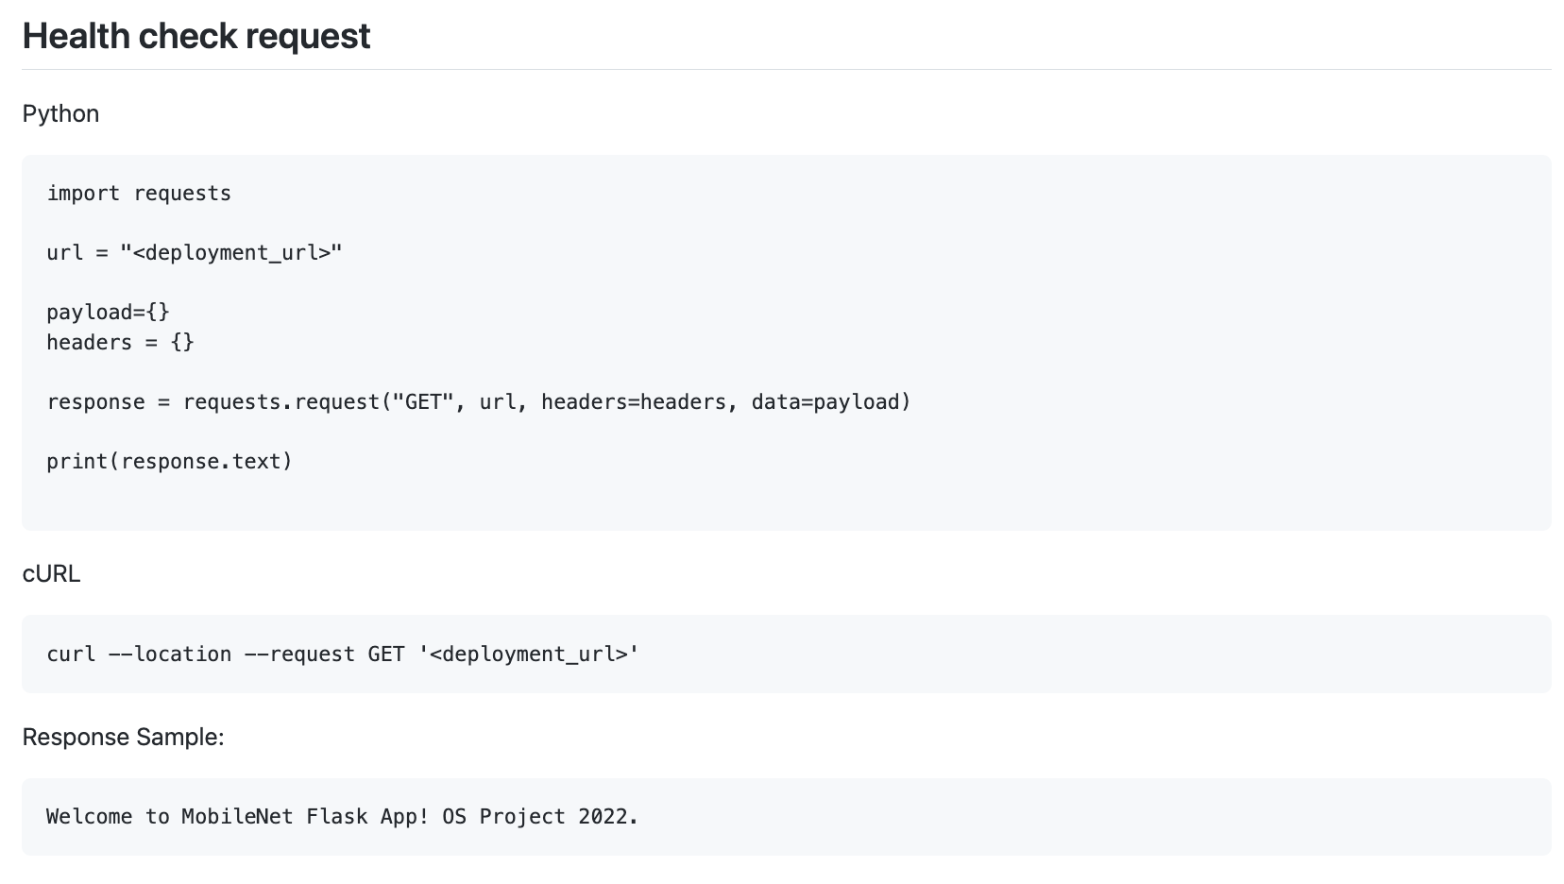

Slide 14
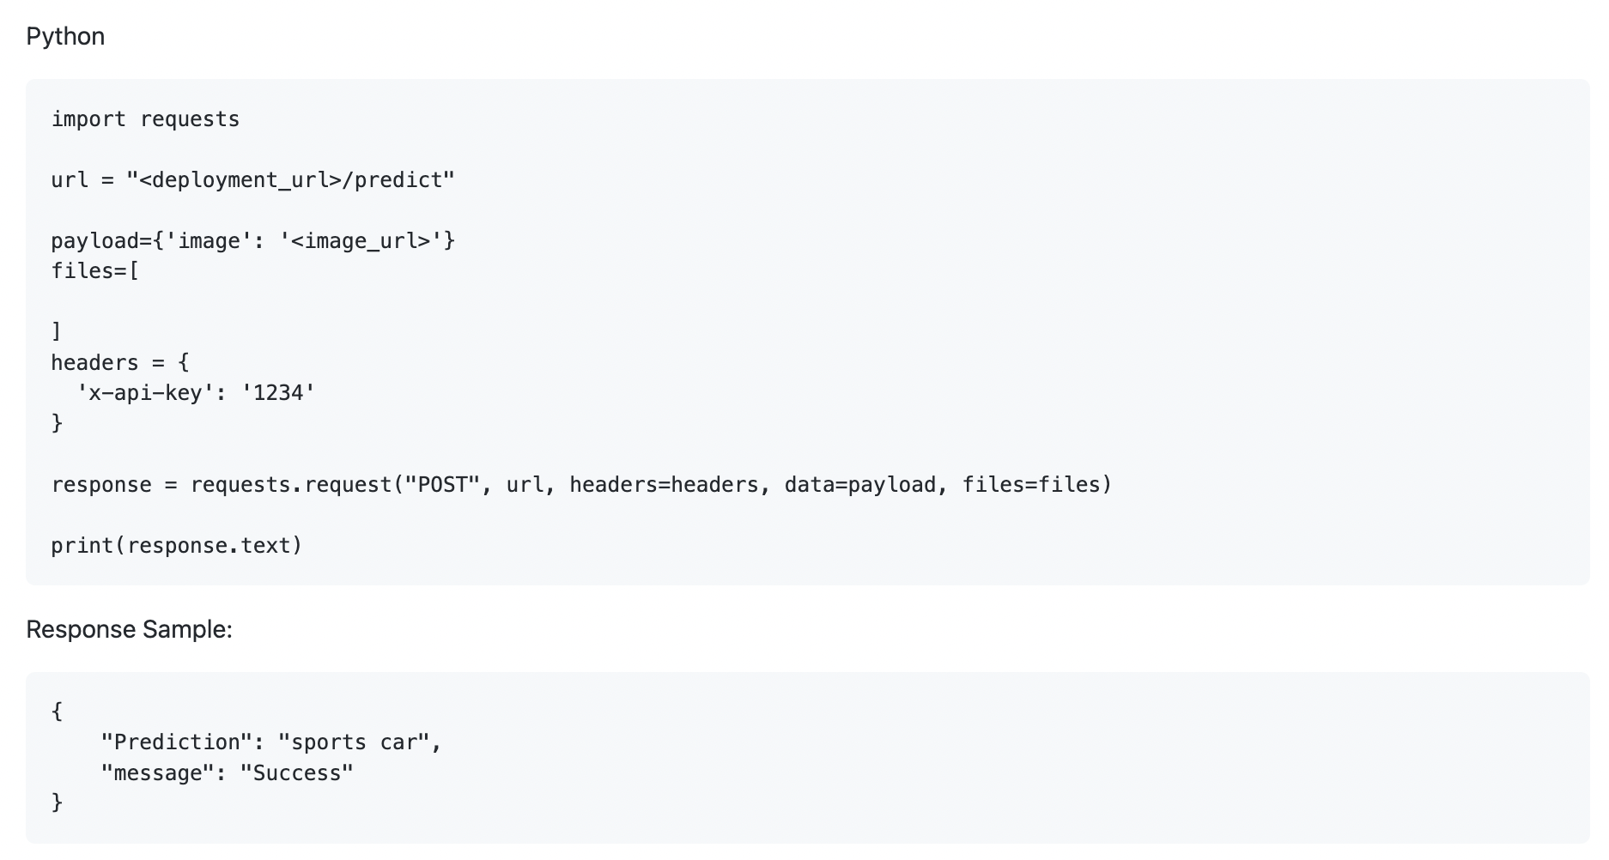

Slide 15
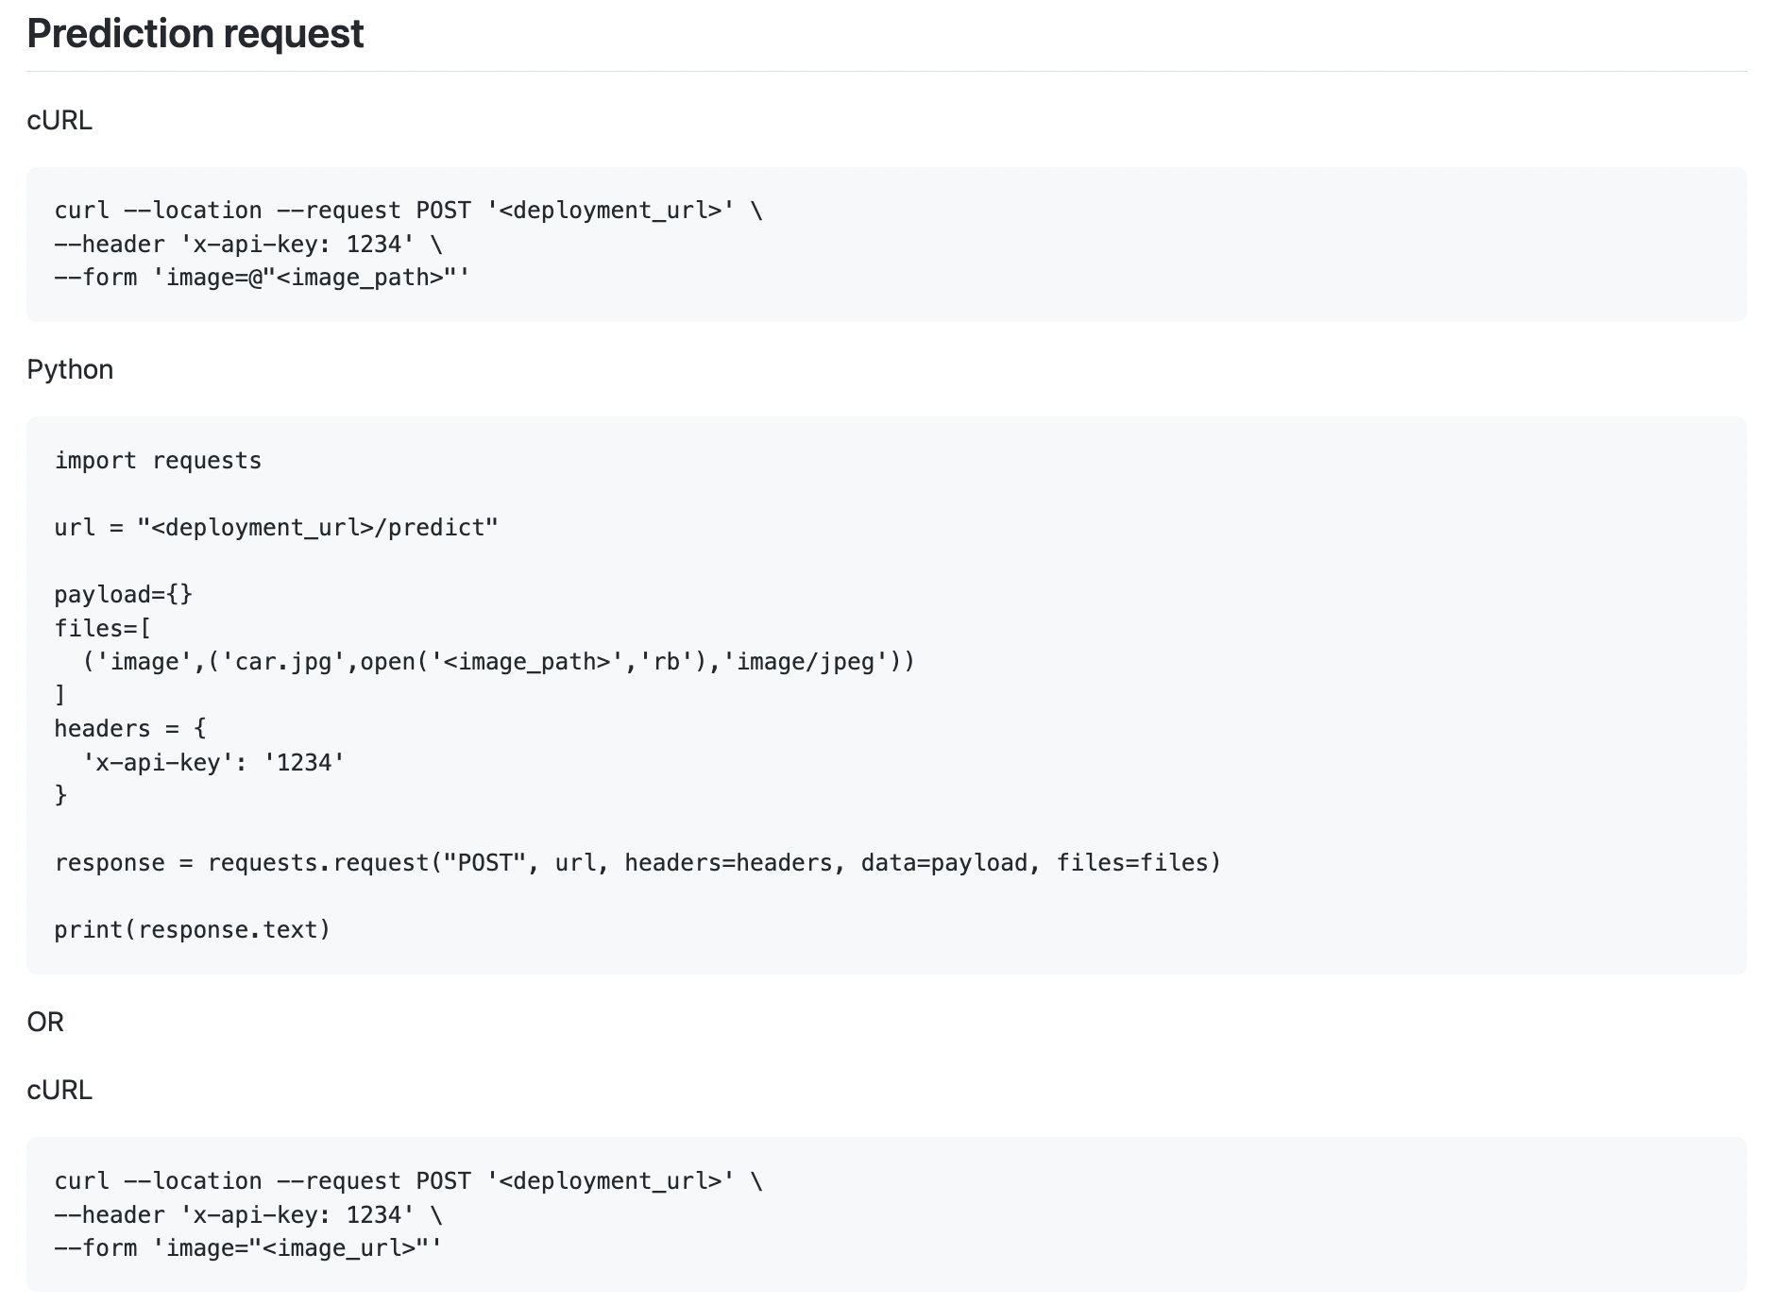

Slide 16
Gunicorn (WSGI)
Takes care of running multiple instances of our web application in a single container using multiple threads.
Perform health check and restart instances as needed.
Distribute requests across the instances and communicate with the web-server.
In our case, we forced the container to have single instance due to memory constraint.

Slide 17
Results and Discussion
Locust load testing result
Locust Results
Cloud Run analytics
CloundRun_MainResults
Very Strong Scalability, Robustness,Portability
Programming languages does not matter.
Easy to learn
Agile Friendly
Microservice should be Integrated with Continuous Integration(CI) and Continuous Delivery(CD) otherwise it will cost too much human resource in maintenance.

Slide 18

THANK YOU!
Department of Computer and Information Sciences University of Delaware
Prerana Khatiwada PhD Student preranak@udel.edu
Pranjal Dhakal
PhD Student dpranjal@udel.edu
Github: https://github.com/pranjal1/ML_Deploy

